Slide 1
Shell Bootcamp 2024 3 Reflections for Week #<>
Atishay Jain
Date : 30-Aug-2024

Slide 2

About Me
I am a dedicated and driven individual who values loyalty, focus and commitment in all the aspects of my life.

Slide 3

My learnings from this week!

Slide 4
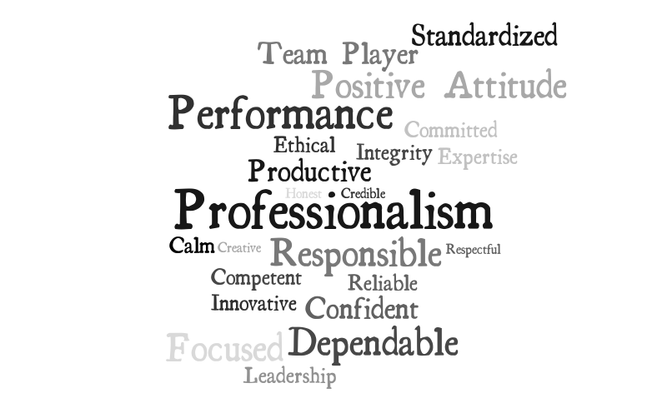
Learning 1 | My takeaways
Who is a professional?
An individual who is skilled and knowledgeable in their field, adhering to the standards and ethics of their profession.
How Does Professional Behave?
Accountability
Reliability
Integrity
Respectfulness
Adaptability

Slide 5
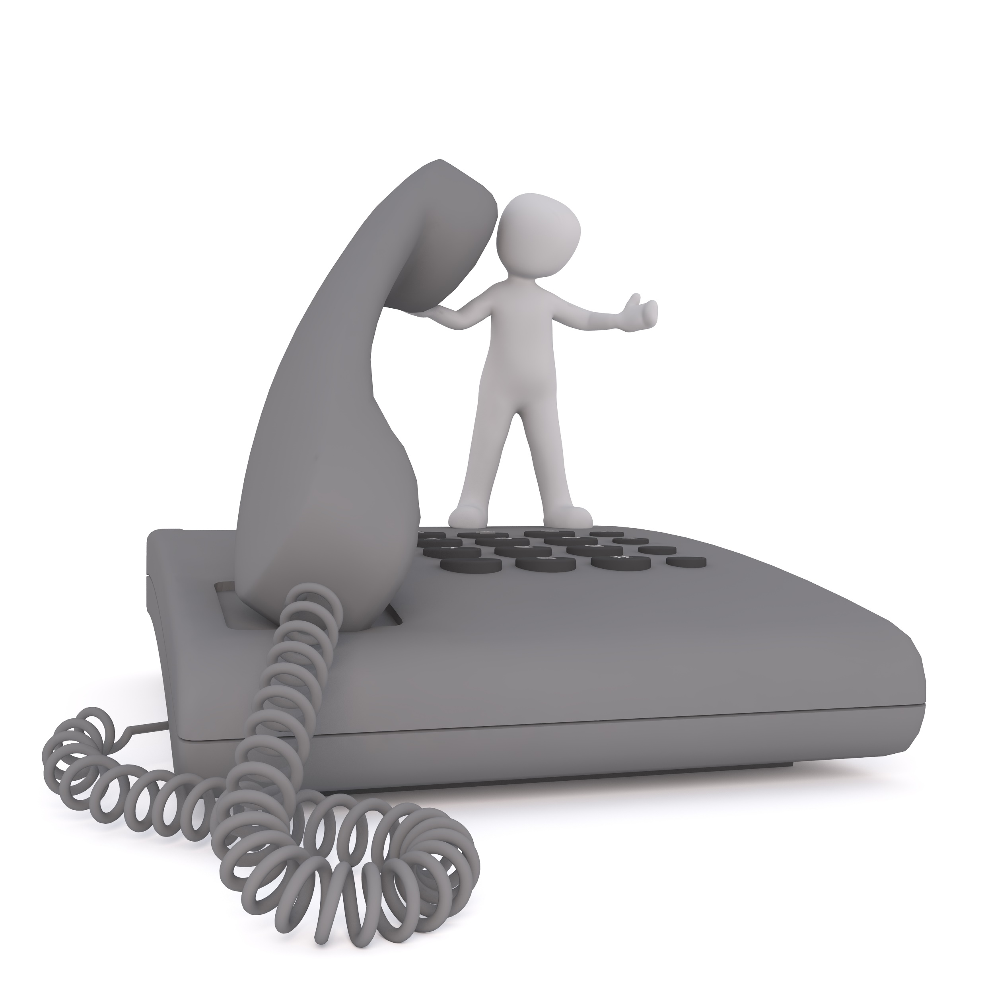
Learning 1 | My takeaways
Professional Qualities and Attributes?
Expertise
Punctuality
Appearance
Self-Discipline.
Telephone Etiquette
Answering: Answer with greeting
Tone: Tone must be polite
Hold: Don’t hold for long and don’t move away
Ending: End with goodbye

Slide 6

Learning 1 | My takeaways
Email Etiquette:
Subject: Don’t use block letters
One email one message
One paragraph(15-20 words) – one idea
Respond within 24 hours
Write designation in signature.
Meeting Etiquette
Be Prepared and on time
Put your phone on silent
Follow-up

Slide 7
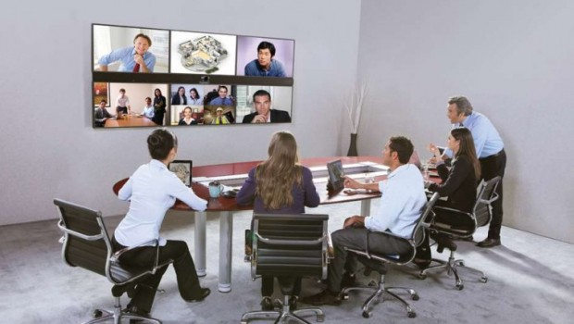
Learning 1 | My takeaways
Video Conferencing Etiquette:
Minimal background distraction
Dress as you’re attending in person
Be on mute if not required
Pay attention and ask question
How do I personally see this concept implemented in the Energy sector : In the Energy sector, Professionalism involves adhering to safety regulations, maintaining technical expertise and ensuring ethical and regulatory compliance.

Slide 8
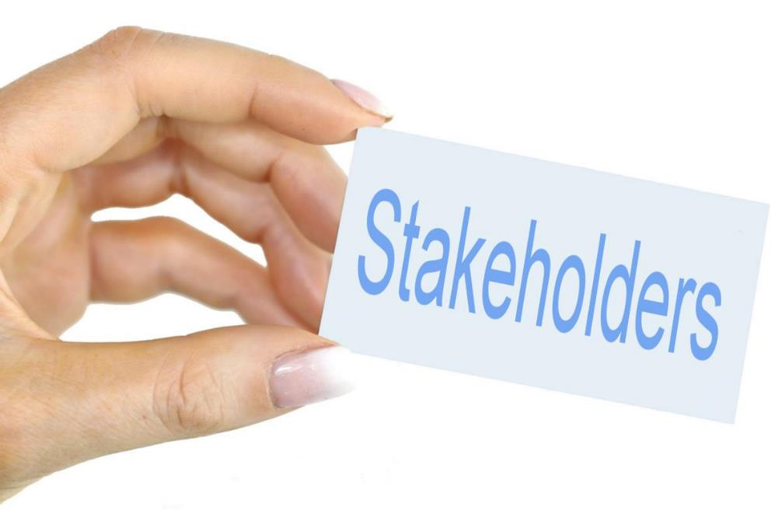
Learning 2 | My takeaways
Stakeholder Analysis
Identify the Stakeholder
Understand Stakeholder
Prioritize stakeholder
Develop a communication plan
Manage and monitor stakeholder expectation
Stakeholder expectation
Transparency
Giving everyone significant amount of say
Physical interaction is best but if it is not possible, you can have another mutually acceptable channel
This Photo by Unknown Author is licensed under CC BY-SA

Slide 9
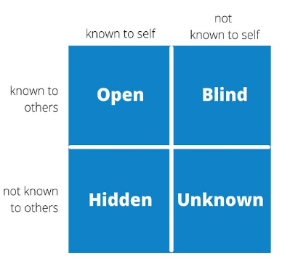
Learning 2 | My takeaways
Shell Trust Model
Credibility
Reliability
Intimacy
Self-Orientation
Trust Enhancing Techniques
Johari Window
4 Quadrants (1- Blind Self, 2- Open Self, 3- Hidden Self and 4- Unknown Self

Slide 10
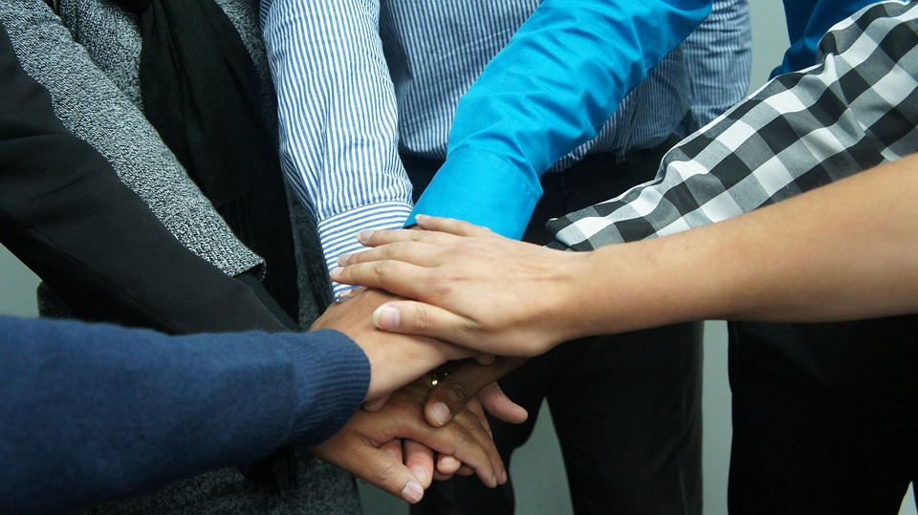
Learning 3 | My takeaways
Benefits of Teamwork
Encourages personal growth and increases job satisfaction
Reduces stress increases efficiency by sharing the workload
Boosts accountability
Stages of Development (Tuckman Model)
Performing
Forming
Storming
Norming

Slide 11
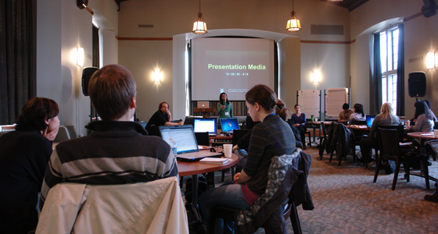
Learning 3 | My takeaways
5P of Presentation
Profile, Pitch, Pace, and Practice
Logical Structure should be followed in PPT
AAB strategy should be followed for presentation
How do I personally see this concept implemented in the Energy sector: In energy sector teamwork and presentation is required to convey the idea and things to be done on time and efficiently.
This Photo by Unknown Author is licensed under CC BY-SA

Slide 12

Learning 4 | My takeaways
Business Analysis
Requirement analysis (functional vs non-functional)
Requirement Elicitation and techniques
Requirement modeling(scenario-based, class-based and data based
Requirement management and its importance
Requirement management techniques (Work breakdown structure, Gantt Chart, Critical path method, waterfall model, Kanban, and Scrum)
[Add a graphic that provides evidence of what you learned]

Slide 13
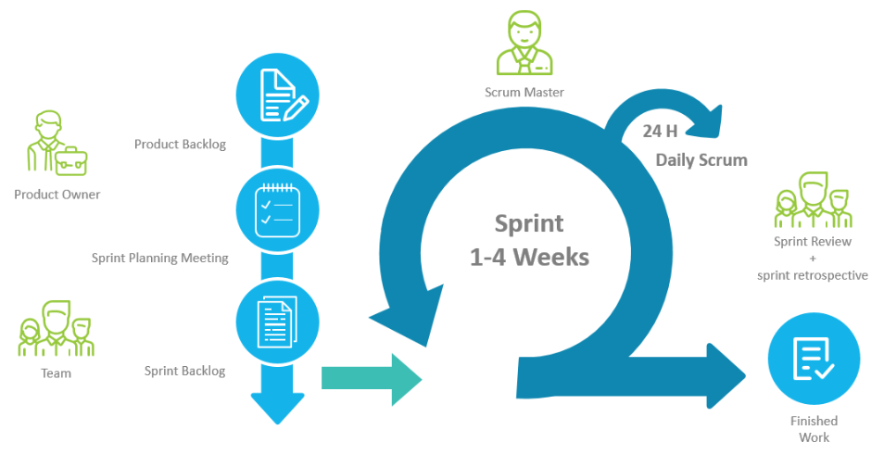
Learning 4 | My takeaways
Agile methodology(SCRUM)
A project management framework that breaks projects down into several dynamic phases, commonly known as sprints.
Scrum is an agile framework for team collaboration and problem solving, inspired by the sport of rugby
Three pillars (Transparency, Inspection and Adaptation)
Time: Sprint(2-4 weeks), Daily scrum(15min), Planning + Review+ Retrospection(2-4) hours
Benefits: Adaptability, High velocity, Continuous improvement, Sustainable pace, Faster problem resolution, customer centric
[Add a graphic that provides evidence of what you learned]
This Photo by Unknown Author is licensed under CC BY-SA-NC

Slide 14
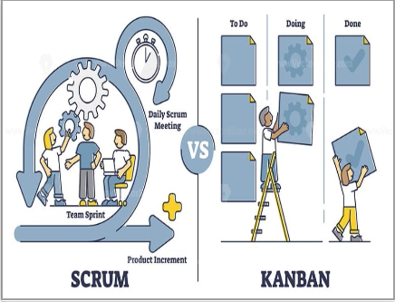
Learning 5 | My takeaways
Components of SCRUM
Epic
User Story
Task
Sub Task
Business Feature
Feature
User Story
Enabler Story
Acceptance Criteria

Slide 15
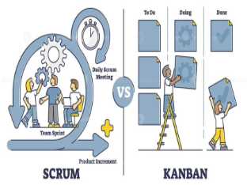
Learning 5 | My takeaways
KANBAN
The Kanban method is an approach to evolutionary and incremental systems and process change for organizations
Story Pointing
Feature
Benefit Hypothesis
Acceptance Criteria
User Story
Enabler Story

Slide 16

Relevance of learnings for my organization

Slide 17

Learning 1 | Relevance for Shell
Implementation of Professionalism in Shell
We set clear expectations and conduct regular performance reviews to ensure team members take ownership of their roles
We use project management tools to track deadlines and deliverables, ensuring consistent performance.
We uphold ethical standards with strict code of conduct
We foster a inclusive environment with diversity training
We support continuous learning and offer cross-training
This Photo by Unknown Author is licensed under CC BY-SA

Slide 18
Learning 2 | Relevance for Shell
Shell aims to provide stakeholder value which is one of the basic operating principle of the organization.
Based on the power and interest shell provides shareholder value to all of its shareholder in some way
Shell implements teamwork by sharing workload reasonably among the team to avoid burn-outs. Also encourages to ask for help when needed
This Photo by Unknown Author is licensed under CC BY-SA

Slide 19
Learning 3 | Relevance for Shell
The benefits of teamwork reflects in the way shell delivers its IT services and products to various clients.
This work-life balance reflects the organization’s remarkable record to be able to retain it’s employees for a longer duration of time.
The way to make PPT’s reflects the organization’s professionalism towards the client meetings
This Photo by Unknown Author is licensed under CC BY-SA

Slide 20
Learning 4 | Relevance for Shell
All the various team working to deliver Shell IT products and services operate under the SCRUM (agile SDLC model) rather than following the traditional waterfall model
This provides flexibility and optimal usage of resources both technical as well as human
Operating under this model all the teams have a daily scrum meeting at the start of the working day in which the tasks for the day are discussed and a follow up meeting at the end of the day
This Photo by Unknown Author is licensed under CC BY-SA

Slide 21
Learning 5 | Relevance for Shell
Shell implements these learnings by conducting Sprints of a given Epic or a feature and follow up meeting regarding the same with the client to make sure they too are satisfied
Shell benefits from this by increasing the transparency to the user and their requirement .
Conducting sprints helps identify the underlying cause of the problem and backlogs
This Photo by Unknown Author is licensed under CC BY-SA

Slide 22

Challenges in implementing learning

Slide 23
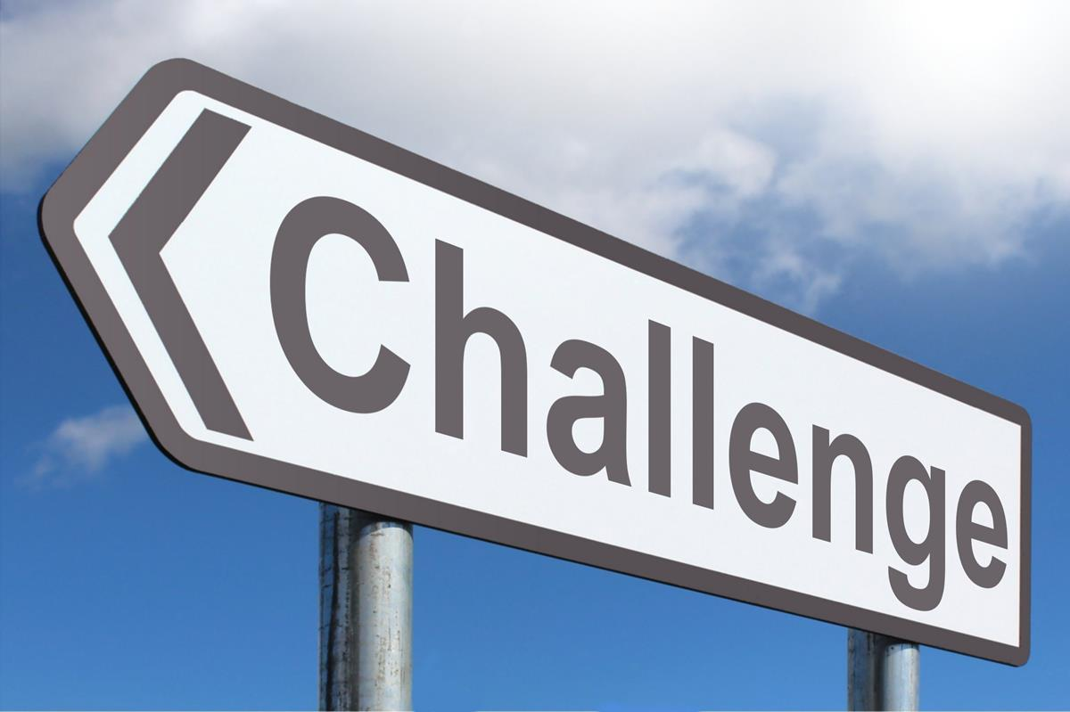
Challenge faced while implementing Learning 1
Challenges faced while implementing
Cultural resistance
Consistency across Regions
Measurement and Accountability
Time Constraints

Slide 24
Challenge faced while implementing Learning 2
Challenge faced while implementing:
Diverse Stakeholder interest
Communication barriers
Resource Allocation

Slide 25
Challenge faced while implementing Learning 3
Challenge faced while implementing
Geographical Dispersion
Diverse Work Cultures leading to misunderstanding sometimes
Role Clarity issues
Resistance to change

Slide 26
Challenge faced while implementing Learning 4
Challenge faced while implementing
Adoption of agile suddenly
Training and Expertise
Integration with my existing knowledge
Continuous adaption

Slide 27
Challenge faced while implementing Learning 5
Challenge faced while implementing
Consistency in story pointing
Implementation Delays
Maintaining discipline
Excessive training

Slide 28

Action Plan

Slide 29
My Action Plan for this Week
Actions
Timeline
Status
→Leaning more about Azure Dev-ops
→Setting up PostgreSQL as a DBMS service
→More GTKY’s from the product owners under my line managers
1 week
Status of the same by the end of the week

Slide 30

Learning is also Fun!

Slide 31

Learning is also Fun!
The sessions were highly interactive, and activity based.
The activities included
Roleplay
Chart making
Public speaking
Presentation skills
Assessments

Slide 32

Summary
The entire first three days of the training focused on the soft skills required in a corporate environment including covering topics of how to interject, criticize(without offending) , how to ask politely to elaborate further on a topic .
Technical skills like Dev-ops on Microsoft Azure , Creating epics, tasks ,feature ,user story in Microsoft Azure cloud
The Topics of the current week will help us better communicate our understanding with the felicitator to gain a much clearer and broader understanding on the subject being taught.

Slide 33
Thank You

